Slide 1

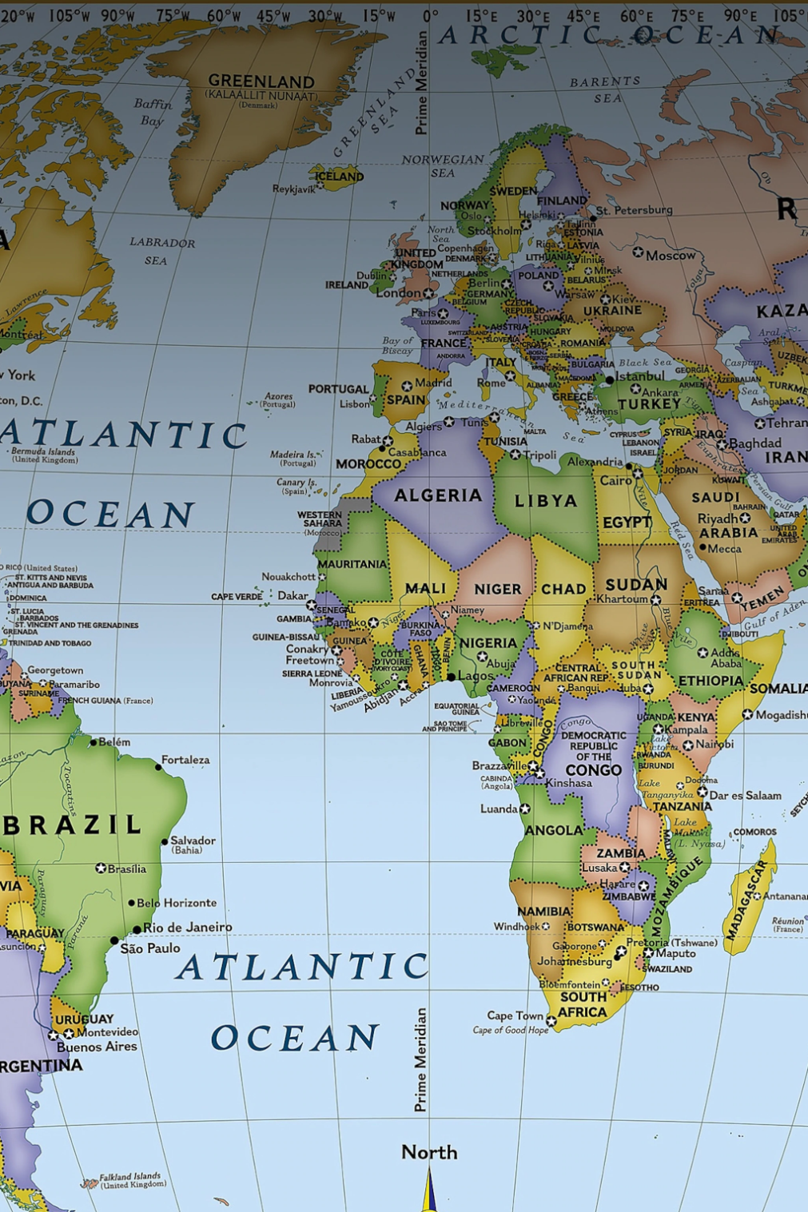
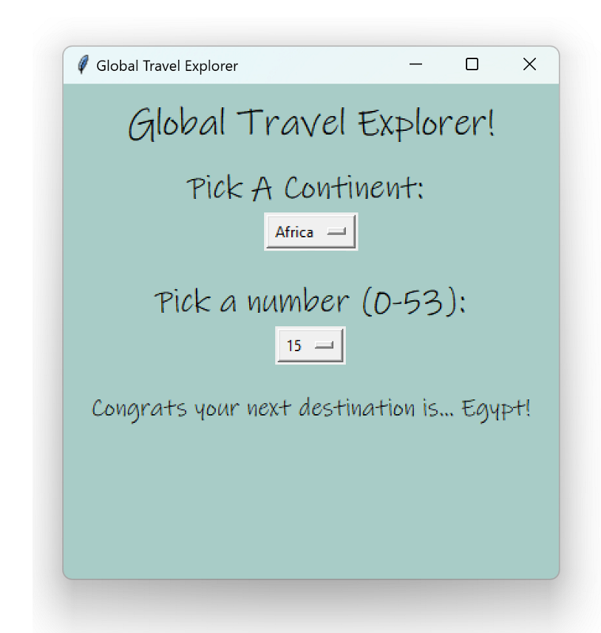
Global Travel Explorer
Africa
Europe
Asia
North America
Global Travel Explorer is a program that helps an indecisive user choose a destination to travel to in the world with just two simple decisions.
South America
Morgan Dennis Jones

